Slide 1


BAH Data Engineering Presentation
<Insert Team number>
<insert Team Name>
Members: <insert team members>
April 2022

Slide 2
TEAM <insert number>: Project <description of project>
Our Official Project for the BAH Data Engineering Program
www.webagesolutions.com|1.877.517.6540

Slide 3




INTRODUCTIONS (replace this with your information)
MICHAEL FORRESTER Senior Technical Trainer
Web Age Solutions
JAMIE HILL Lead Associate
Program Manager
ZACHARY LEWIS Associate
Digital Programs
SCOTT CORMACK Senior Consultant
Digital Programs

Slide 4
Project
Introductions
Project Overview
Architecture/Design diagram
Tools/Software Environment used
Challenges/Issues/Problems/Your stories
What have you learned/learned?
What else can we do on the project? - future plan- any design and implementation ideas?
Demo
Questions and answers
Serverless website with authentication and database backend
www.webagesolutions.com|1.877.517.6540

Slide 5
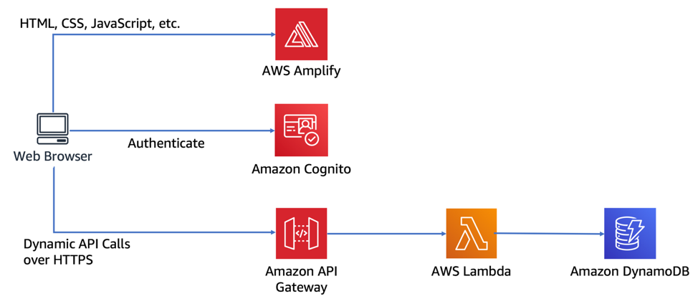
Architecture and Design

Slide 6
Technologies and Environment used
AWS CodeCommit
AWS Amplify
Amazon Cognito
Amazon API Gateway
AWS Lambda
Amazon DynamoDB

Slide 7
Challenges and Issues
Stories about your Project
Issues
Challenges
Learning
etc.

Slide 8
Demo

Slide 9
Q & A - Ask us anything

Slide 10
Thank you!!!
MARCH 2021

